Slide 1
Hospital Appointment System
Group 3
Sukhbat Amartugs
Nomin Nergui
Myo Min Tun

Slide 2
System Overview
The Hospital Appointment System will help to manage patient appointments in a hospital or clinic and that an administrator can use to add new doctors to the staff, create new patient records, and manage staff schedules.

Slide 3
Problem Statement
The Hospital Appointment System is for receptionists to book appointments only during available time slots. Each patient session will have a fixed duration of one hour to maintain consistency. Additionally, receptionists will be able to manage appointment statuses by marking them as "IN" (checked-in), "OUT" (completed), or "CANCELLED" to track the patient's visit in real-time.
On the administrative side, the system will allow administrators to manage doctor profiles, including their specialties, working hours, and schedules. Administrators will also have control over staff management. Full access to all appointment and patient information will be provided to administrators, allowing them to oversee operations effectively and maintain accurate records.
This solution will reduce scheduling conflicts, improve staff coordination, and enhance the overall patient experience through efficient management and real-time information access.

Slide 4
Use Cases
1. Schedule Appointment
When a receptionist is logged into the system, he/she can see the appointments and selects the option to schedule a new appointment, they are presented with a form to enter the patient ID, doctor selection, and appointment date/time. After submitting the form, the system checks for available time slots and confirms the booking.
2. Check In/Out appointment
When a patient arrives for their appointment, the receptionist check in the patient and after a patient's appointment is completed, the receptionist checks out their appointment and save the appointment history. If patients request to cancel their appointment the receptionist would cancel the appointment.

Slide 5
Use Cases
3. Manage Doctors / Register Them
When an administrator is logged into the system and selects the option to manage doctors, they can add a new doctor or edit/remove an existing one by filling out a form with fields for doctor ID, name, specialty, and availability, with the system persisting the doctor’s information.
4. Manage Patients / Create Patient Record
When an administrator is logged into the system and selects the option to manage patients, they can create a new patient record or edit/remove an existing record by filling out a form with fields for patient ID, name, contact information, and medical history, and the system will persist the patient’s information.

Slide 6
Use Cases
5. Manage Staff Schedules
When an administrator is logged into the system and selects the option to manage staff schedules, they can choose a doctor to adjust their schedule and set or modify their working hours and availability, with the system saving the updated schedule.
6. Add Prescription
When a doctor is logged into the system after seeing a patient, they can select the option to add a prescription, search for the patient by name or ID, enter prescription details including medication, dosage, and instructions, and the system saves the prescription in the patient’s medical record.

Slide 7
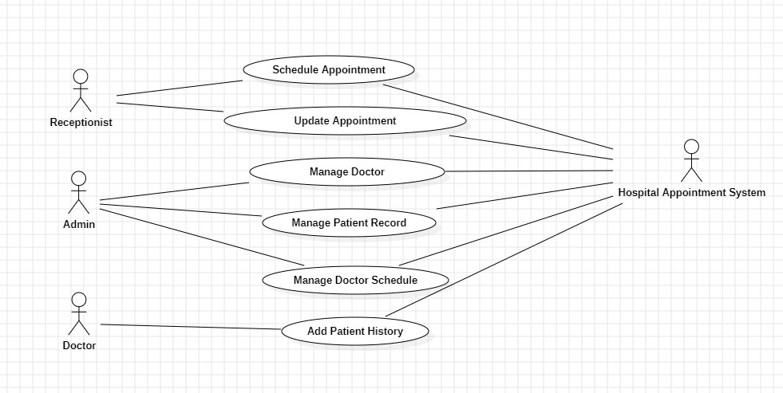
Use Cases

Slide 8
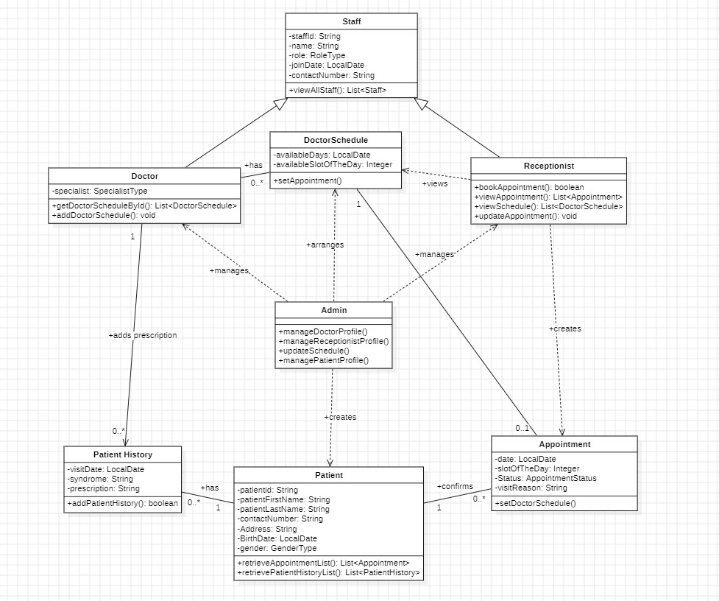
Class Diagram

Slide 9
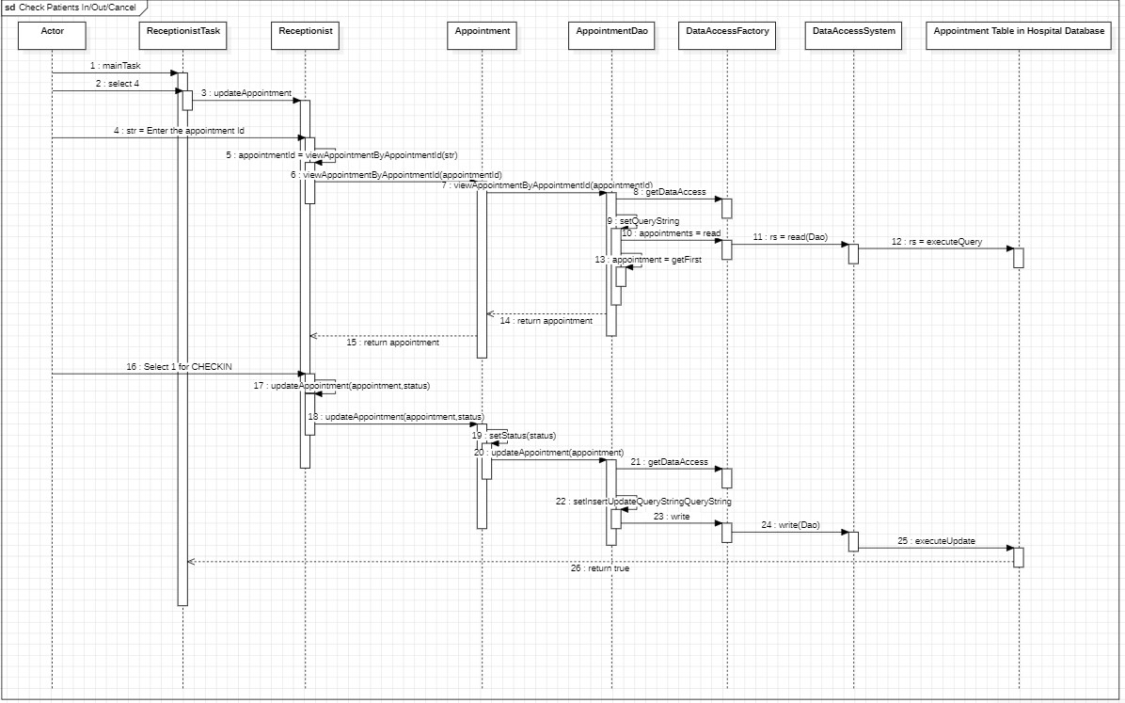
Sequence Diagrams
Update Appointment

Slide 10
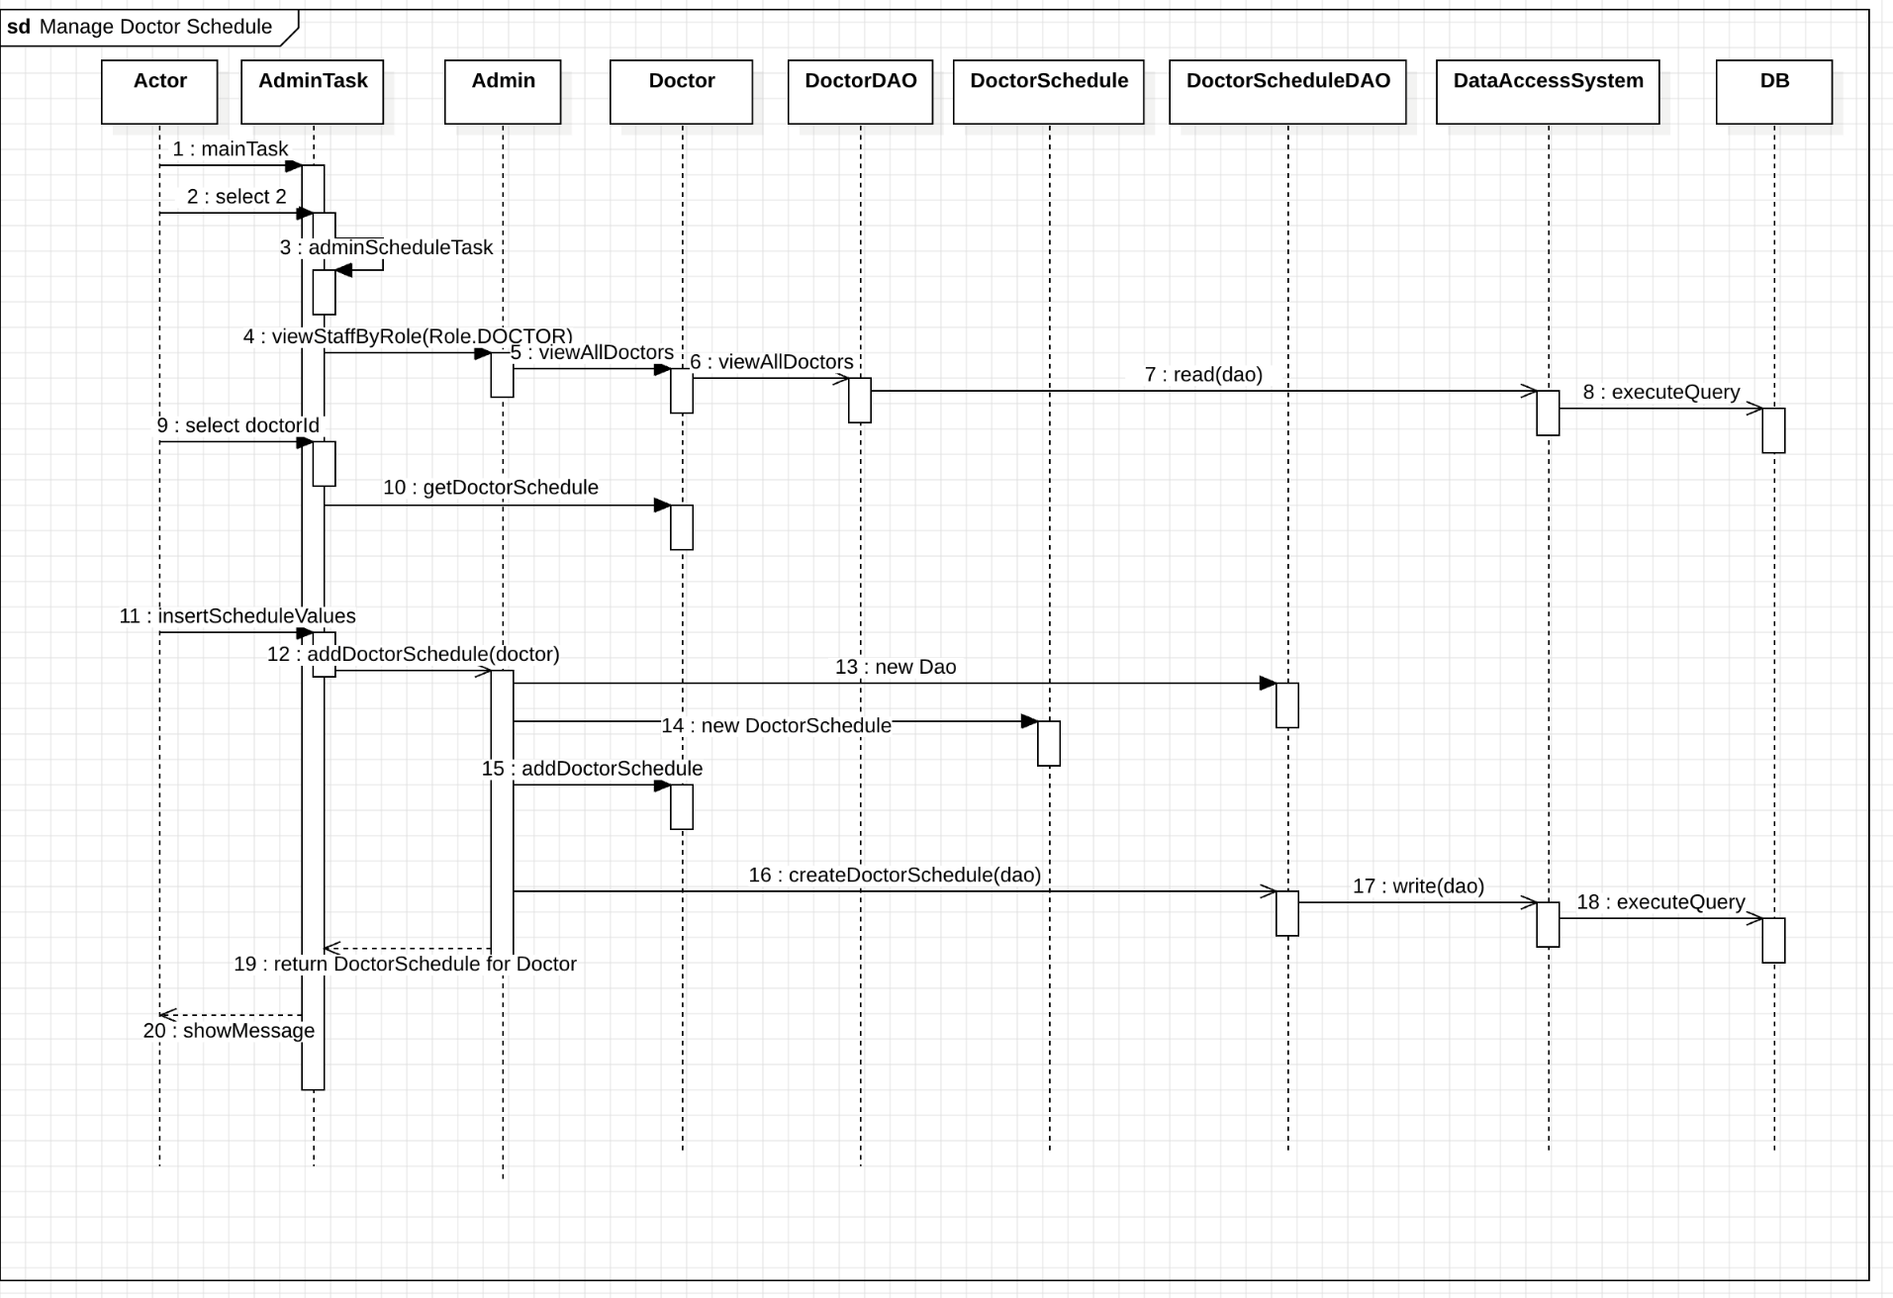
Sequence Diagrams
Manage Doctor Schedule

Slide 11
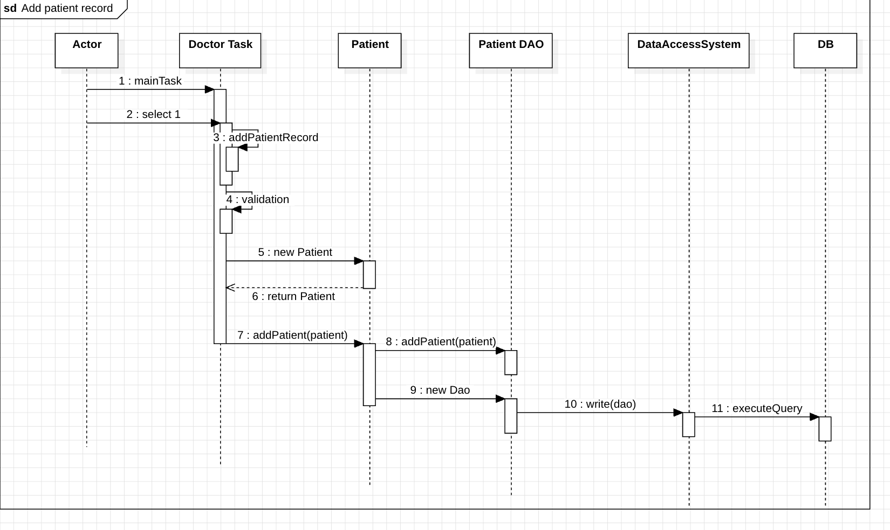
Sequence Diagrams
Add Patient Record Sequence Diagram

Slide 12
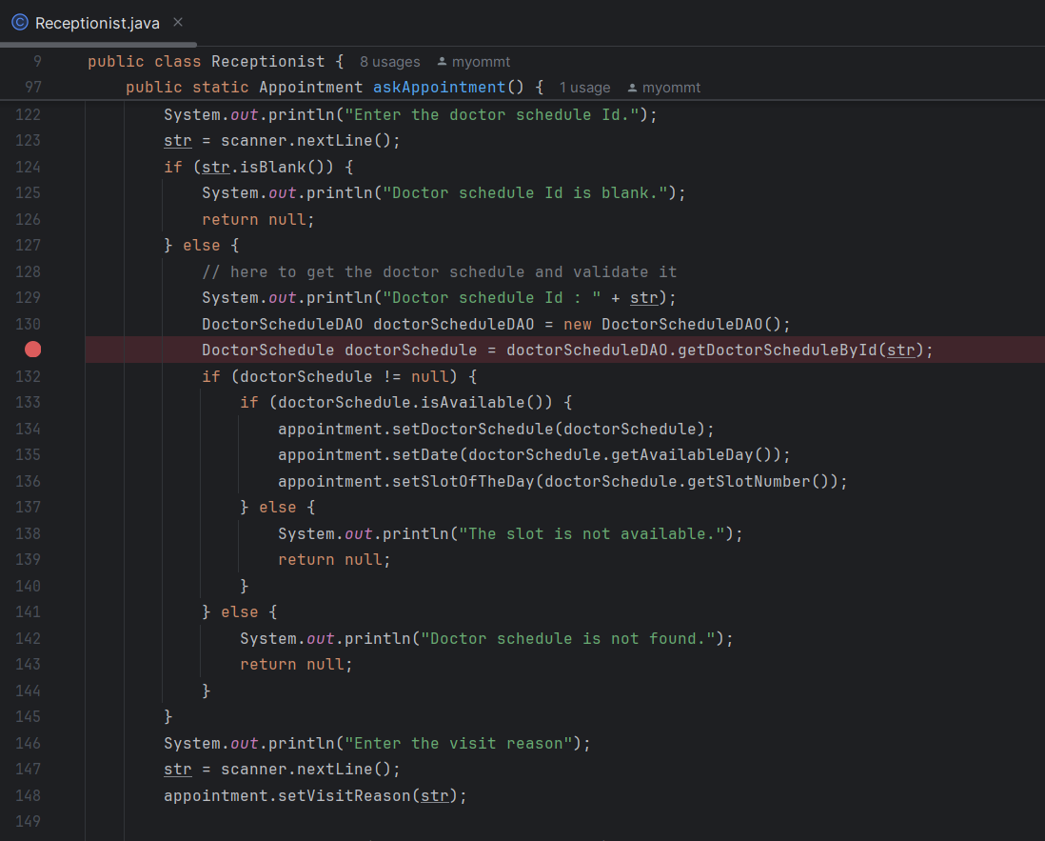
Validation
Validation before creating an Appointment 1. Patient Id should not be blank. 2. If Patient is not found, cannot proceed to book an appointment. 3. Doctor schedule should not be blank. 4. If Doctor schedule is not found, cannot proceed to book an appointment. 5. If Doctor schedule is already booked by another appointment, cannot be reused to book the appointment.

Slide 13
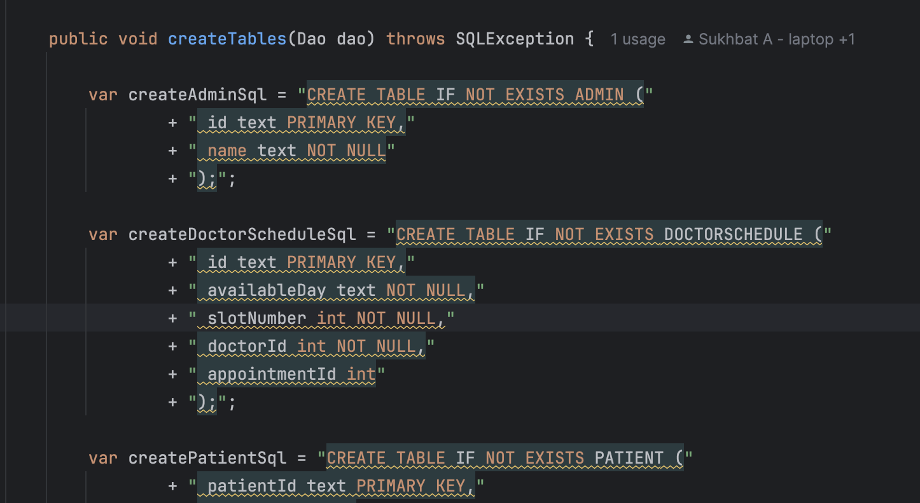
Validation For Database
Validation for data integrity
We used database constraints for the data integrity
1. Primary KEY: To check no unique ids can be same.
2. NOT NULL: some fields should not be nullable

Slide 14
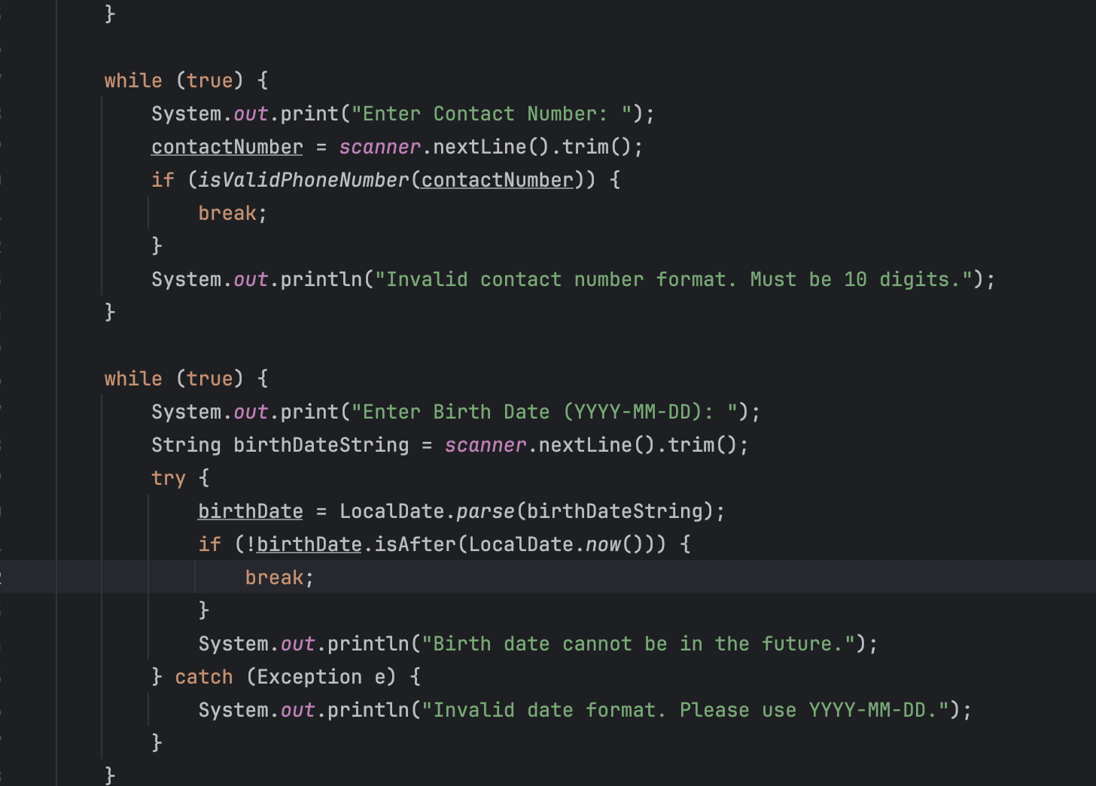
Validation For Inputs
Validation for data input
We check whether the user correctly input the data
For example:
1. ContactNumber: Regex check
2. birthdate: Cannot be in the future, LocalDate conversion

Slide 15
Conclusion with STC Knowledge
java stream
In Java Streams, functional programming enables easy and efficient data processing, just as pure consciousness holds nature’s laws, guiding effortless flow in the universe. Similarly, Java Streams offer a structured, rule-based way to transform and retrieve data, achieving optimized results through clear, simple syntax.
Functional interface
Functional interfaces simplify coding by using single methods for clear and efficient code. Pure consciousness show how simplicity and clarity are valuable and understanding our mind.

Slide 16
Thank you

